Slide 1
TouchDEsigner Interactivity

Slide 2
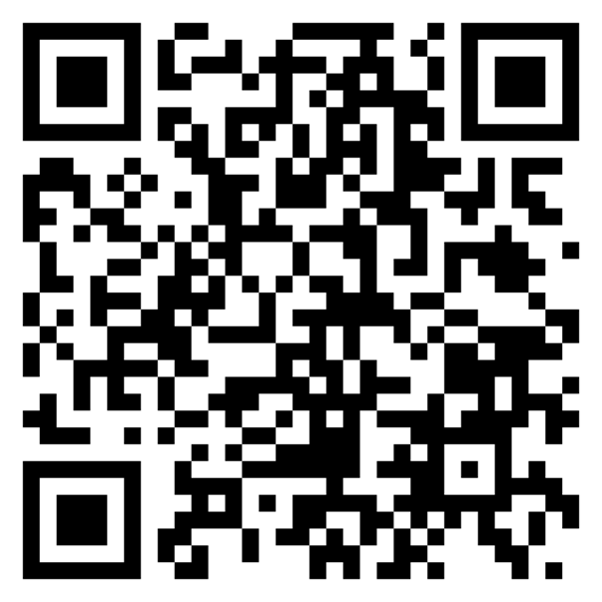
Git repository
https://github.com/Rauleal/AVD-Minor-HU/

Slide 3
Wide range of Possibilities
Sensor I
Serial
Firmata
Computer
Keyboard
Mouse
Joystick
Mapping
NDI
Kantanmapper
User Interfaces
TouchOsc
Osc communication
MIDI
Mapping
TouchOSCBridge
Sensors II
ESP8266
Osc again
Camera
Basic Camera
Motion detection from palet
Color detection
NVIDIA (windows)
Background removal
Body track

Slide 4


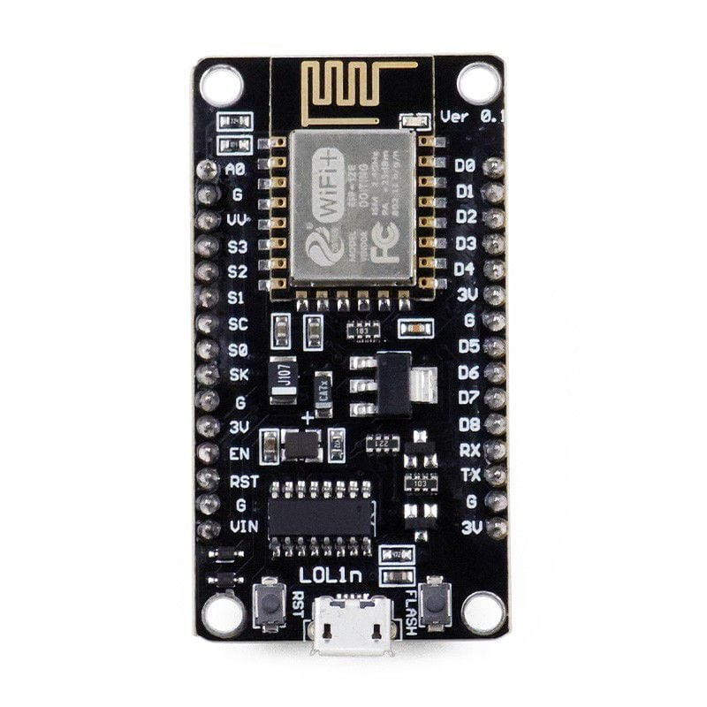
Architecture for installations
Data Processing
Visualization
Orchestration
Logic
Raw sensor data collection
Device Control

Slide 5

Sensors I Arduino

Slide 6
Use Trail and Analyze chop to smooth signal

Slide 7
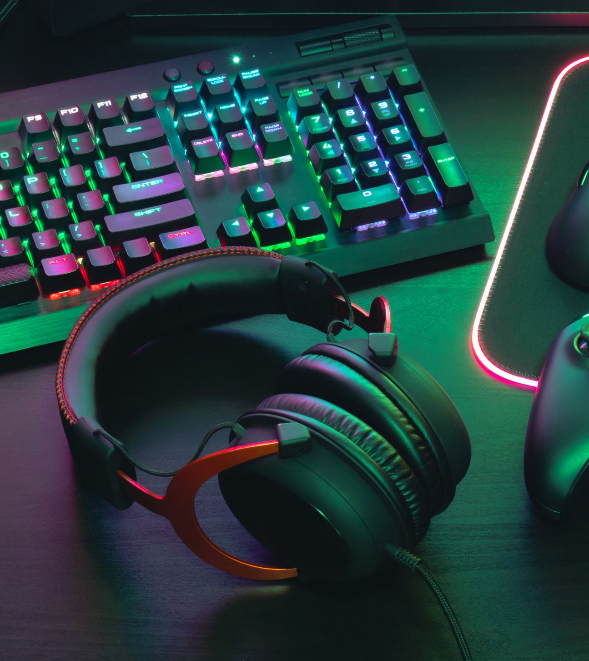
Computer

Slide 8
Out of the box nodes for
Keyboard
Mouse
Joystick
You will need some mapping to get it right

Slide 9
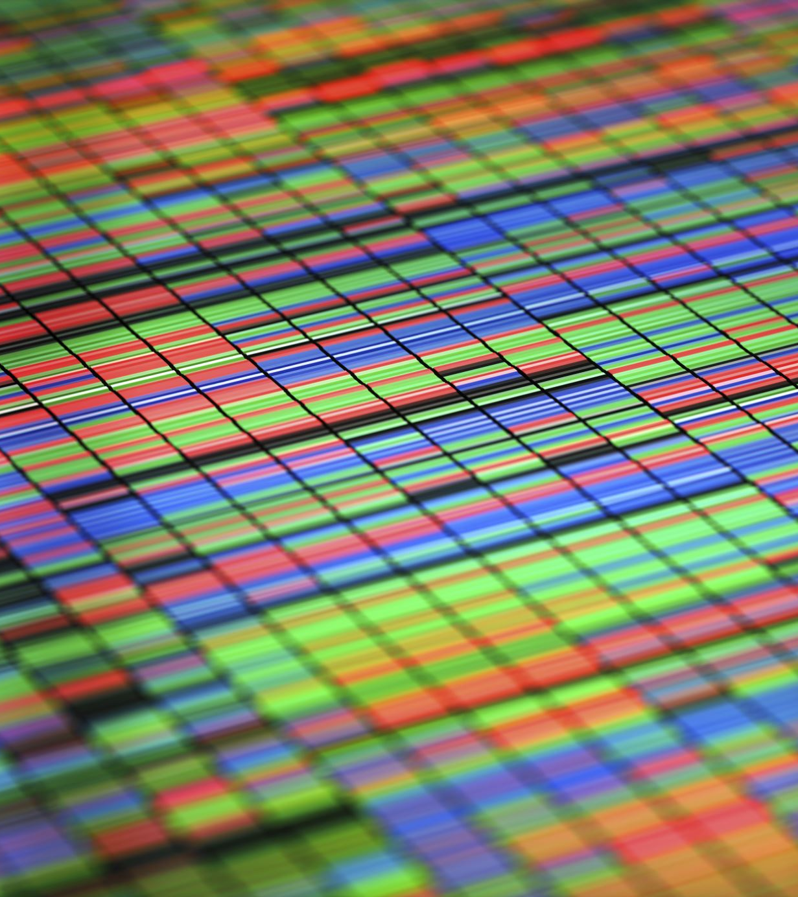
Projection Mapping

Slide 10
NDI
Allows you to stream video to other application or devices
Kantan Mapper
TD tool for mapping
Light version building version of MadMaper
Takes a lot of resources

Slide 11
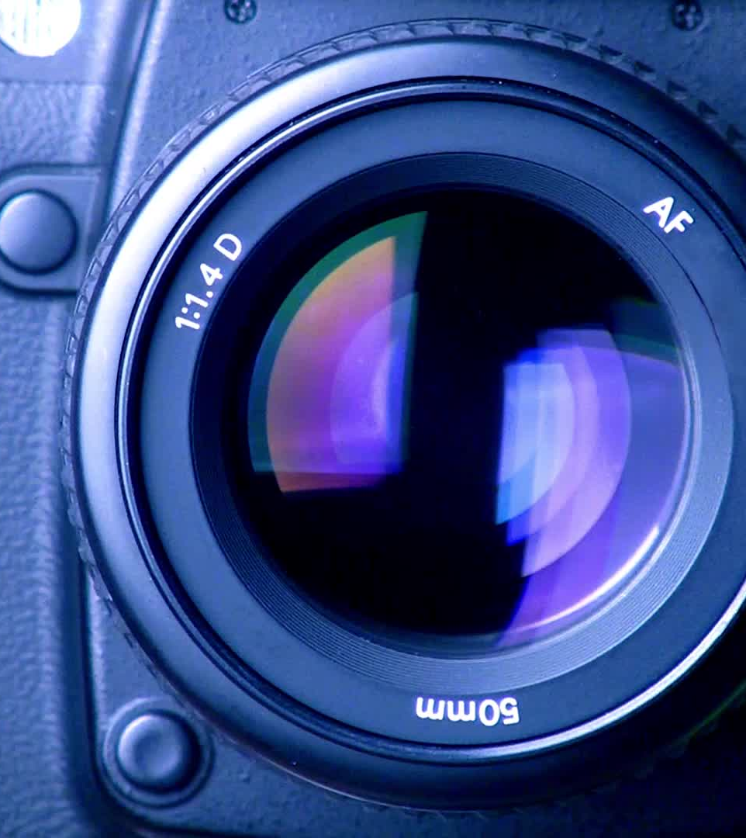
Camera

Slide 12
A camera is also a (light) sensor.
It is the most common sensor used nowadays
TD offer several possibilities to profit from this.
For Windows users, NVIDIA has powerful AI TD nodes
Body track
Background removal
For Mac users, the only “cheap” motion sensor you can use.
Motion tracking with no Kinect

Slide 13
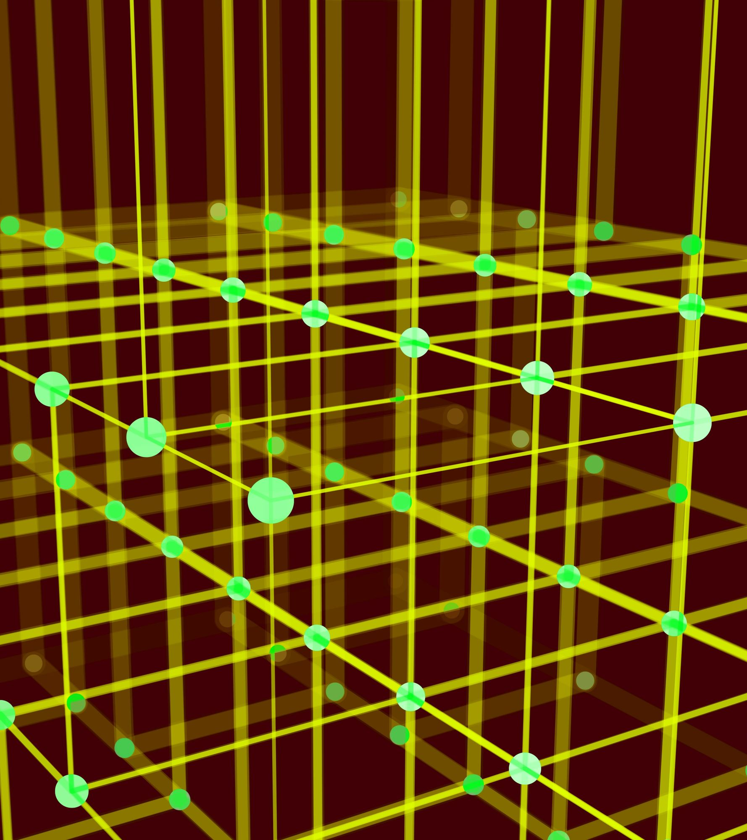
User Interfaces

Slide 14
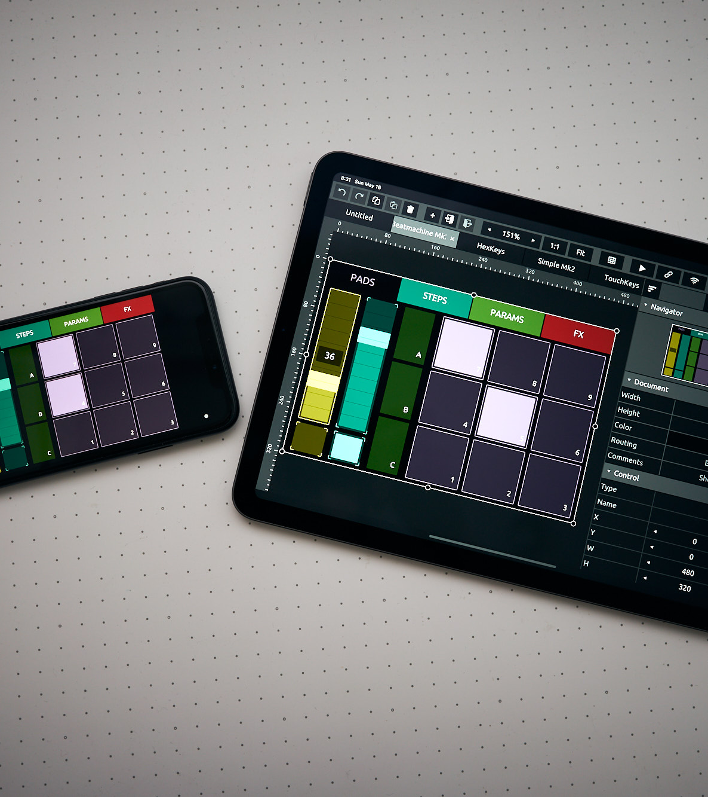
Touch OSC

Slide 15
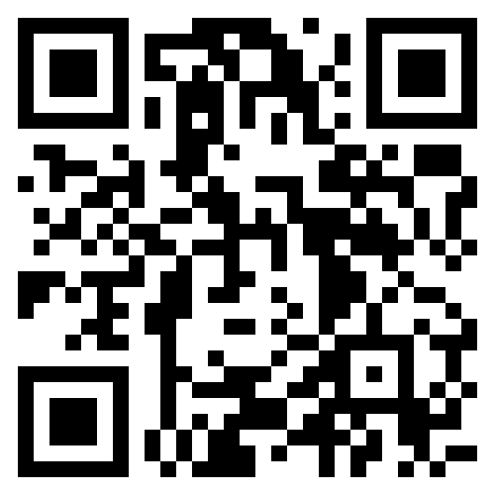
TouchOSC
A touchscreen MIDI and OSC control app
Very stable
Interfaces on tablets and smart phones
Integrates with everything
Often used with TD
Desktop version is free
App version needs purchase (10 euro)

Slide 16
Open Sound Control (OSC)
Protocol based on messages which can be transported across the internet.
You do not need cables, just the same WiFi and open ports.
It does not work with EDUROAM!!!
You need a hotspot
Standard message build up to send and receive message
Out of the box TD nodes to send and receive messages
Nowadays many apps integrate OSC communication

Slide 17
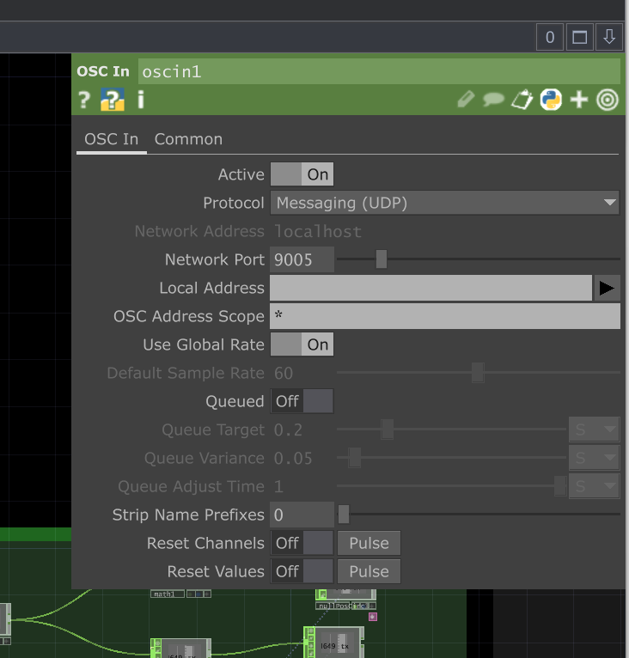
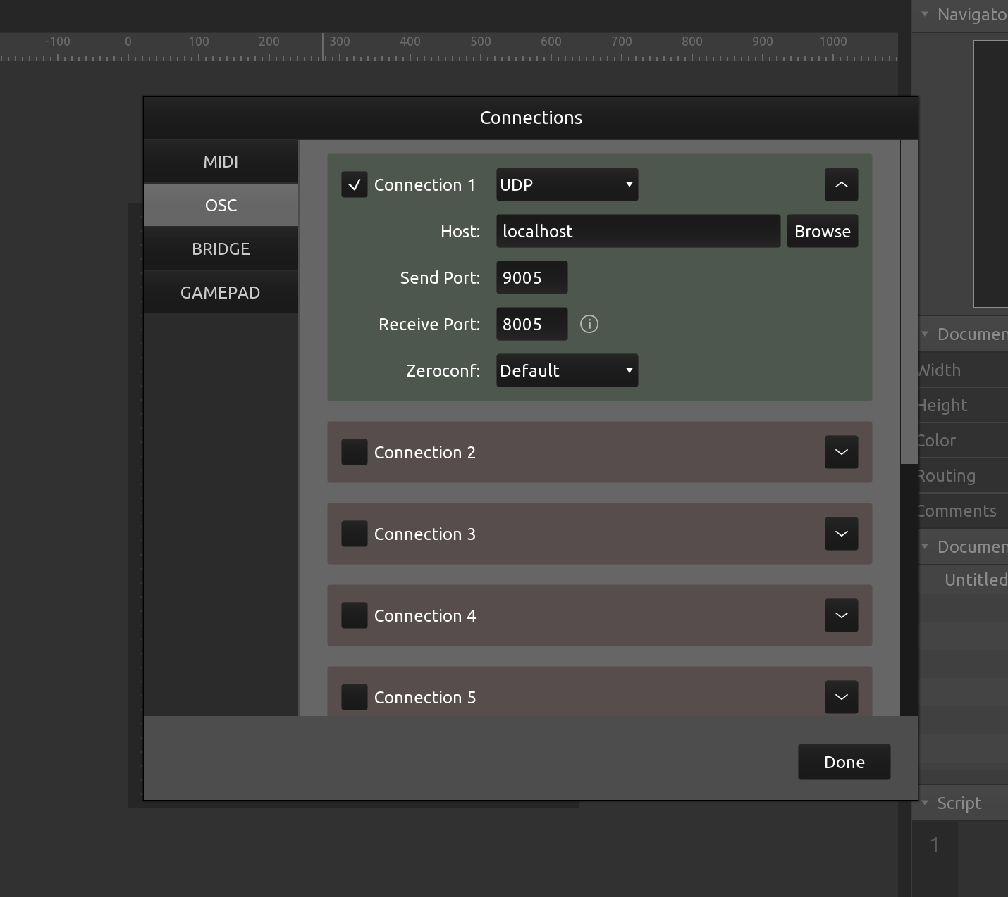
OSC configuration
Host IP address
TouchOSC
TouchDesigner

Slide 18

MIDI Controloers

Slide 19
Different from touch interfaces (touchOSC) Midi controllers offer a more physical interface
They can detect pressure
You can use more than one controller at the time
MIDI controllers have values between 0 and 128
Out-of-the-box TD nodes to send and receive midi Messages
Using Midi and TD
You will need a mapping
TouchOSCBridge provides a cable connection that allows you to connect touchOSC as MIDI

Slide 20
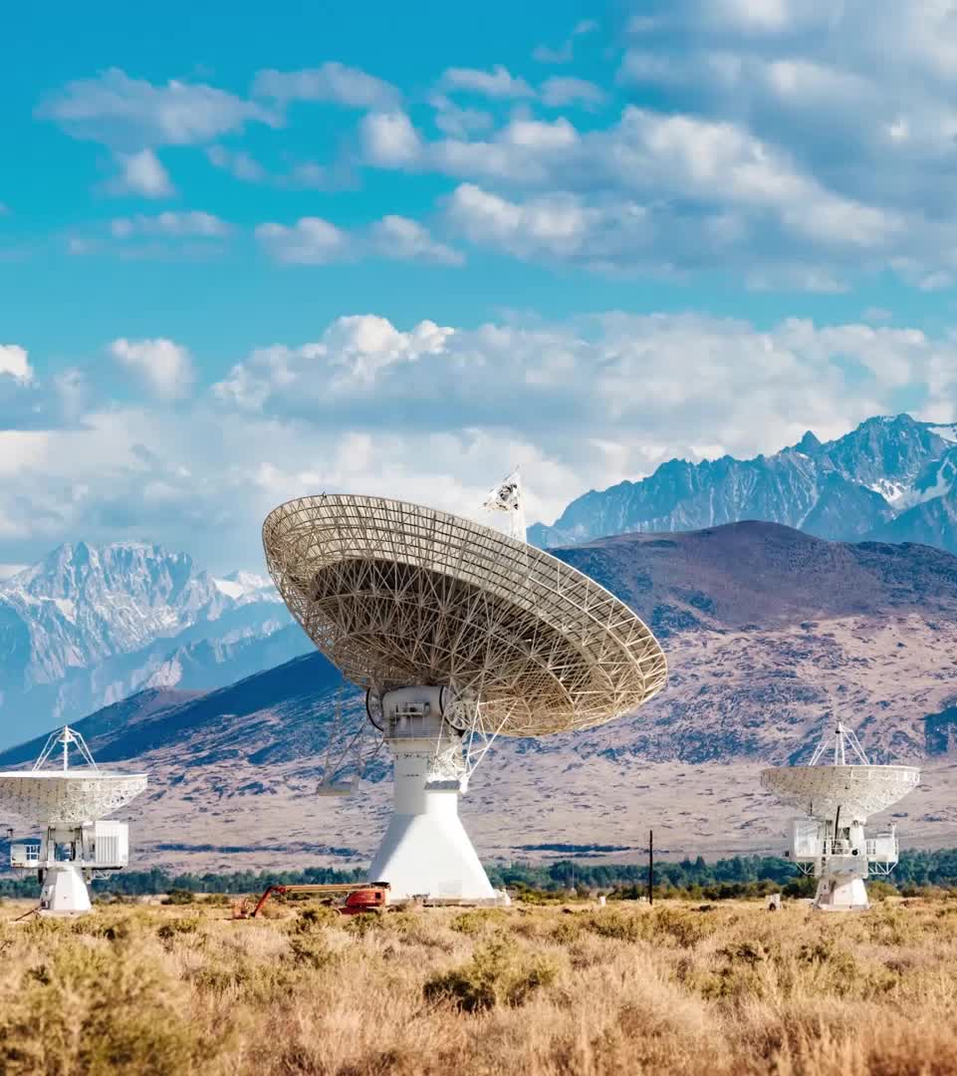
Sensors II Wireless

Slide 21
ESP8266
Cheap microcontroller alternative to Arduino
Arduinos cost 14 to 30 euros, this one costs 4 to 6 euros
Integrated WiFi and Bluetooth connectivity
you can connect wirelessly
Ideal to connect things to a Mac

Slide 22
ESP8266 Installation
Follow installation instructions here https://randomnerdtutorials.com/how-to-install-esp8266-board-arduino-ide/
If you can not find the port, install the usb drivers alsohttps://randomnerdtutorials.com/install-esp32-esp8266-usb-drivers-cp210x-windows/
Install OSC Arduino library

Slide 23
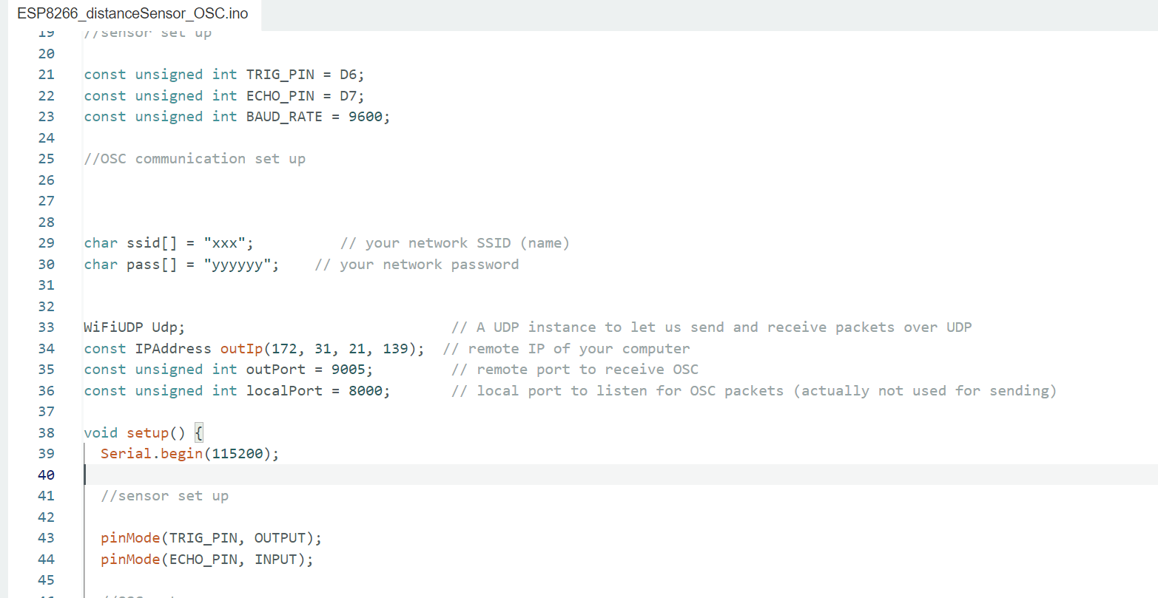
OSC configuration
Internet Credentials
Host IP address
ESP8266
TouchDesigner

Slide 24
Challenge

Slide 25
Challenge 8
Make a 2 to 3-minute projection mapping show using at least two of the following elements.
It is interactive for viewers with at least one “sensor”.
It has an interface where you can control part of it.
It uses content/data from another group wirelessly.
Present on 15:15
Tip: Divide the work/components

Slide 26
Tools

Slide 27
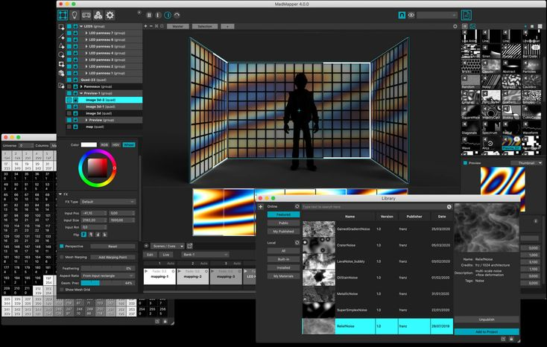



Slide 28
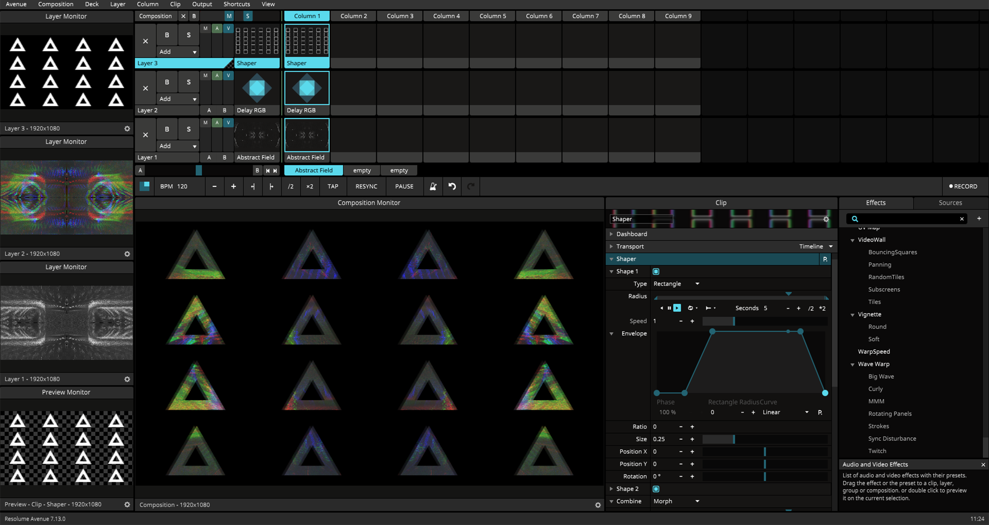


Slide 29
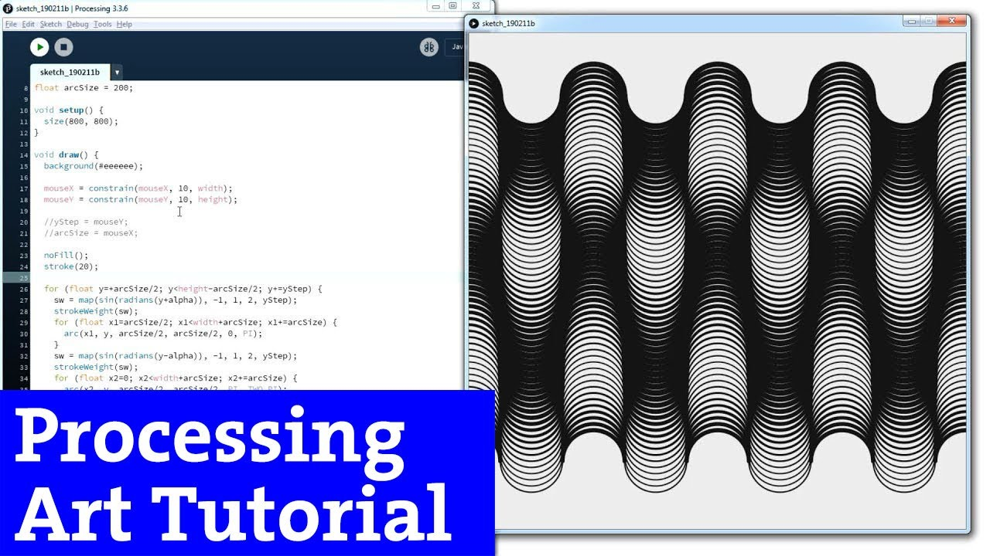

Slide 30
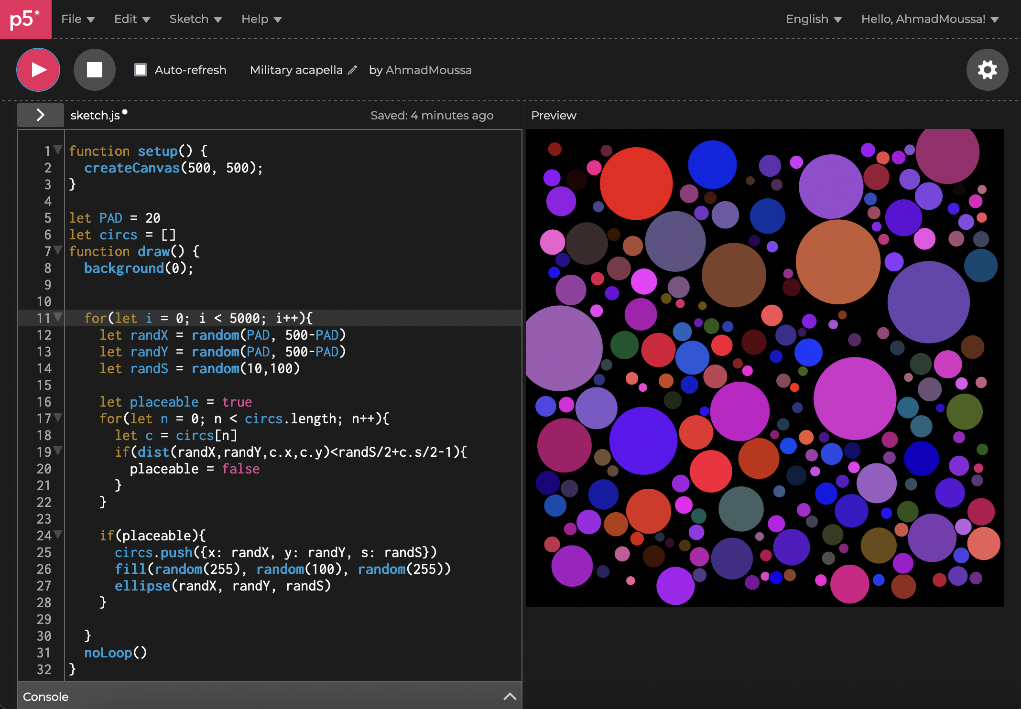


Slide 31
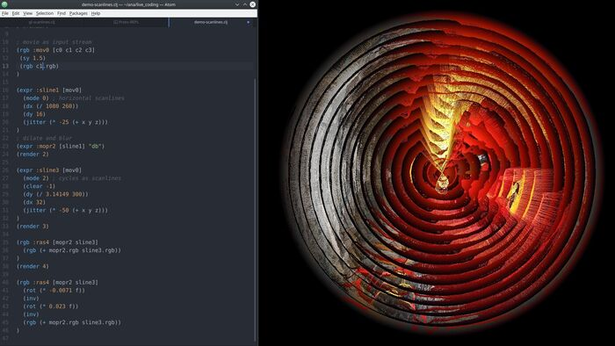


Slide 32
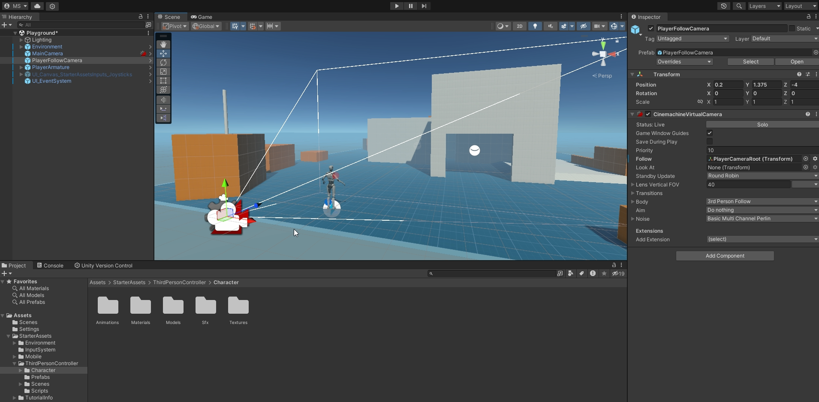


Slide 33
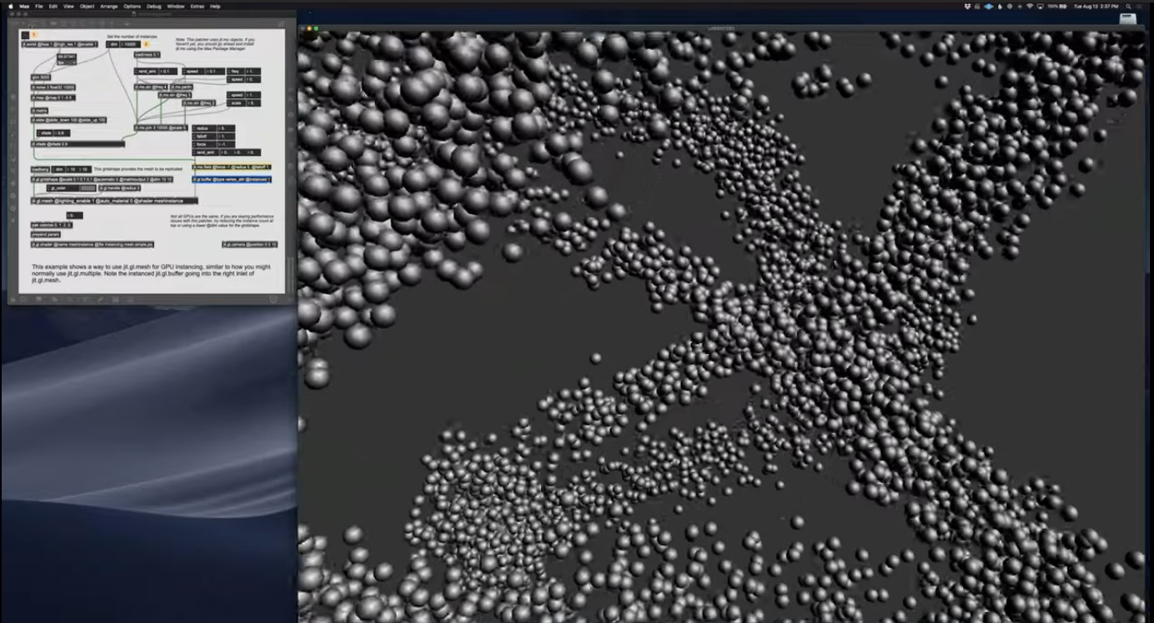
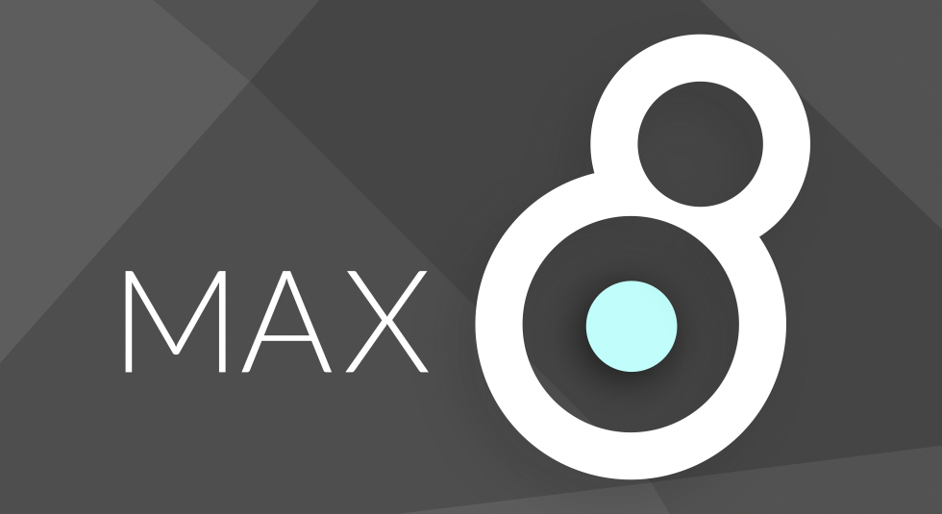

Slide 34
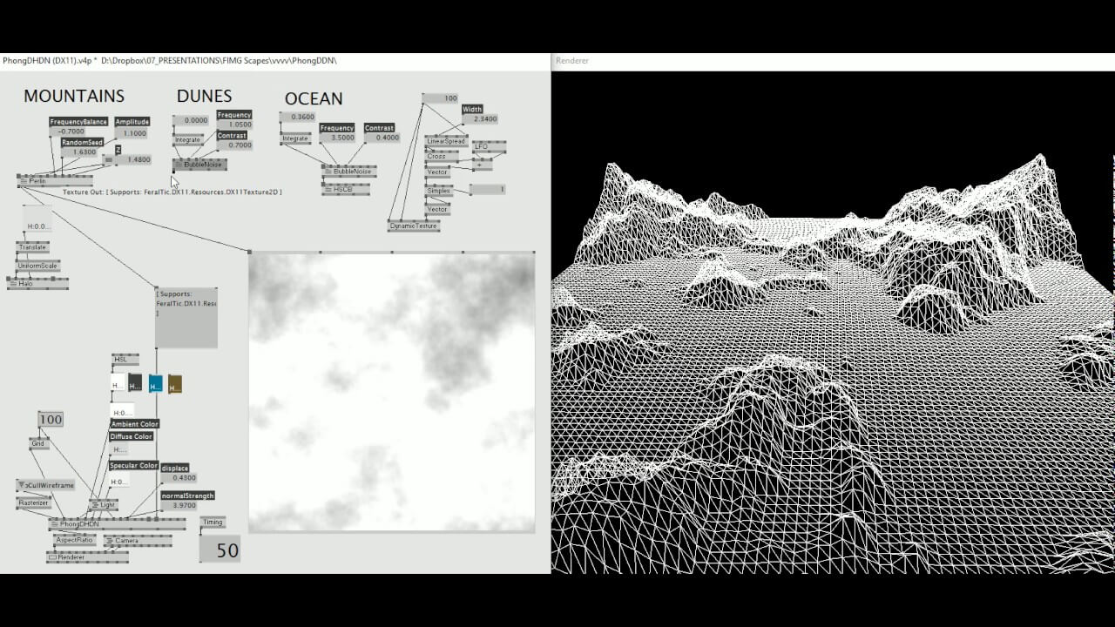


Slide 35
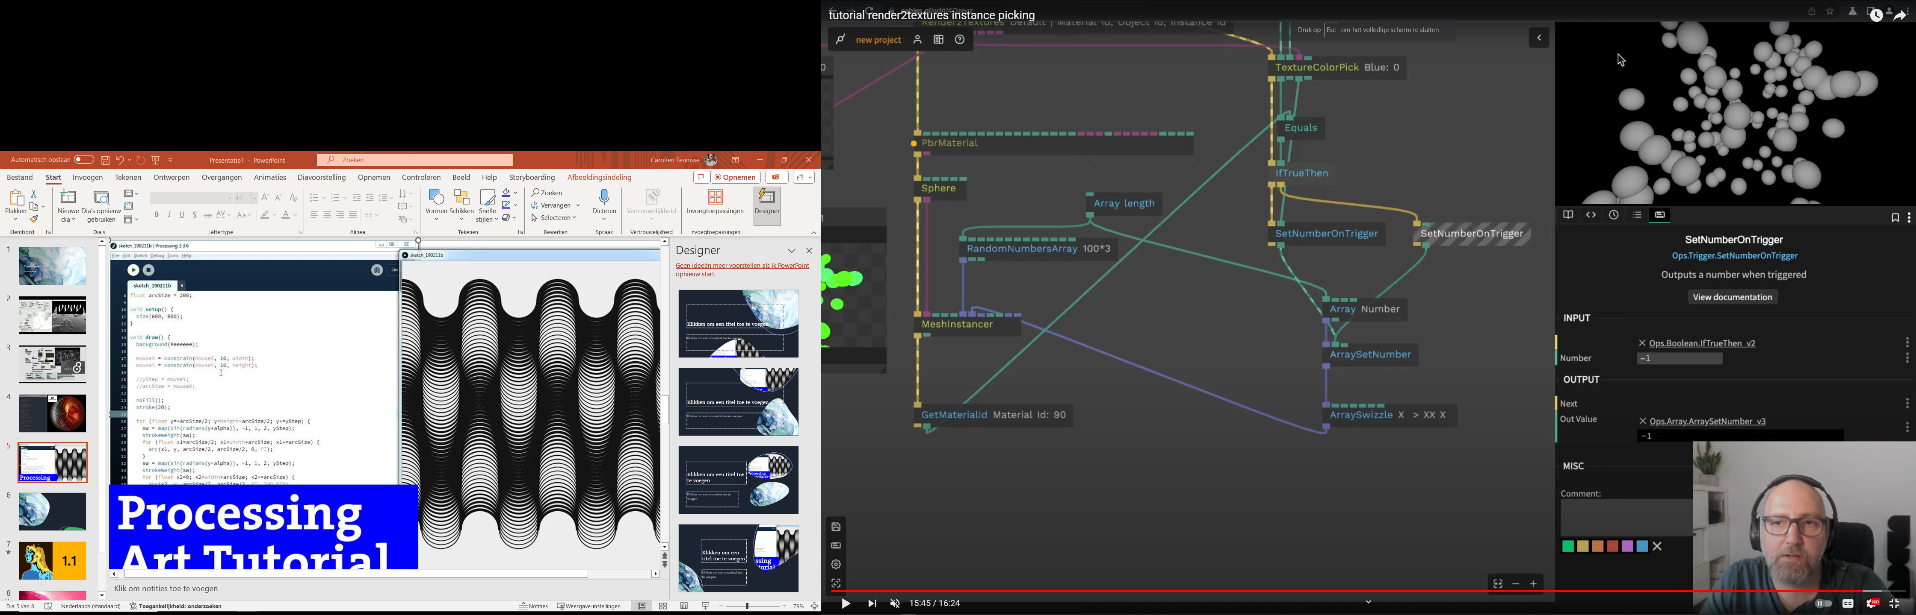


Slide 36
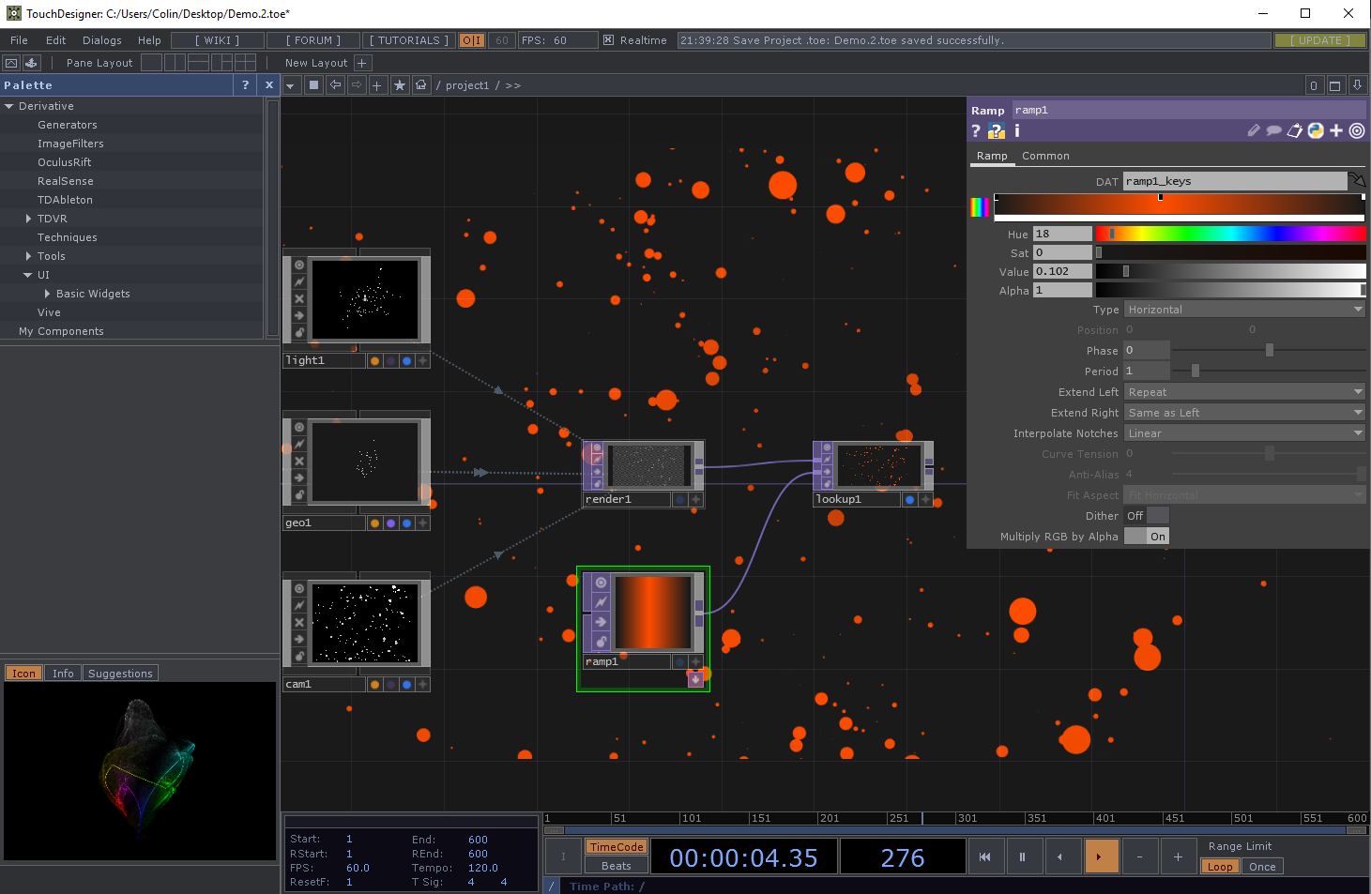

Recommended
by
Raul

Slide 37

Advice: Choose 1 or 2 and take the Pain

Slide 38

Thank you

